Slide 1


Ermesa Pepe
05/02/2024

Slide 2

Outline
Executive Summary
Introduction
Methodology
Results
Conclusion
Appendix

Slide 3
Executive Summary
The purpose of this analysis was to evaluate the performance of several classification models built for predicting the success of Falcon 9’s first-stage landings. The accuracy of each model was assessed, and the results were visualised in a bar chart to facilitate comparison.
A total of five classification models were evaluated: Support Vector Machine (SVM), Decision Trees, Logistic Regression, and K-Nearest Neighbors (KNN). Each model’s accuracy was calculated based on its performance on the test dataset.
The bar chart clearly illustrates the varying levels of accuracy achieved by each model. Among the models evaluated, the Decision Tree exhibited the highest accuracy at 94%, followed closely by SVM, Logistic Regression, and KNN, which demonstrated 83%.
These findings provide valuable insights into the effectiveness of different classification algorithms for predicting the success of Falcon 9 first-stage landings. SpaceY can leverage this information to select the most suitable model for their needs and optimise their decision-making processes.
Moving forward, further refinements and optimisations to the classification models can be explored to enhance their predictive performance and reliability. Additionally, ongoing monitoring and evaluation of model performance will be essential to ensure continued effectiveness in real-world applications.

Slide 4
Introduction
Project background and context
SpaceX advertises Falcon 9 rocket launches on its website at 62 million dollars; other providers cost upwards of 165 million dollars each. Much of the savings is because SpaceX can reuse the first stage. Therefore if we can determine if the first stage will land, we can determine the cost of a launch. This information can be used if an alternate company wants to bid against SpaceX for a rocket launch
Problems you want to find answers
The problem we want to solve is How we can predict if the Falcon 9 first stage will land successfully maximizing the accuracy on which the first stage will land.

Slide 5

Section 1

Slide 6
Methodology
Executive Summary
Data collection methodology
API and Web scraping
Perform data wrangling
Transformation and Standardization
Perform exploratory data analysis (EDA) using visualisation and SQL
Perform interactive visual analytics using Folium and Plotly Dash
Perform predictive analysis using classification models
SVM, Decision Tree, KNN, and Logistic Regression evaluated on accuracy.

Slide 7
Data Collection
SpaceX launch data is gathered from an API, specifically the SpaceX REST API. Data is completed by performing web scraping from a Wikipedia page titled “List of Falcon 9 and Falcon Heavy launches”.
Data is completed by performing web scraping to collect Falcon 9 historical launch records from a Wikipedia page titled List of Falcon 9 and Falcon Heavy launches
Data Collection APIs: SpaceX provides access to certain datasets through APIs
Publicly Available Information: Some data, such as information are publicly available
SpaceX launch data gathered from an API, specifically the SpaceX REST API.
Data is completed by performing web scraping from a Wikipedia page titled “List of Falcon 9 and Falcon Heavy launches”.

Slide 8
Data Collection – SpaceX API
Start
Display and Process Data
End
Choose API Endpoint
Launchpads, Payloads Rockets, cores.
Make API Request
Receive Response
Parse Response Data
Data Collection consists mainly in:
Request to the SpaceX API
Clean the requested data
The flowchart shows the basic steps involved in a SpaceX API call
GitHub URL of the completed SpaceX API calls notebook:
https://github.com/clorofilla/SpaceX-Project/blob/34a063f339288d1ad34217a962c0057c545b62d4/jupyter-labs-spacex-data-collection-api.ipynb

Slide 9
Data Collection - Scraping
The flow shows the steps to collect Falcon 9 historical launch records:
Extract a Falcon 9 launch records HTML table from Wikipedia
Parse the table and convert it into a Pandas data frame
GitHub URL of the completed web scraping notebook:
https://github.com/clorofilla/SpaceX-Project/blob/34a063f339288d1ad34217a962c0057c545b62d4/jupyter-labs-webscraping.ipynb
Start
Display and Process Data
End
Choose webpage
Extract Falcon 9 Launch Records HTML Table from Wikipedia
Download HTML Table
Parse HTML Table
Convert Table to Pandas DataFrame

Slide 10
Data Wrangling
The data wrangling phase mainly consists of reviewing some dataset attributes and converting landing outcomes into Training Labels, with 1 meaning the booster successfully landed and 0 meaning it was unsuccessful. All details are available on the GitHub repository:
https://github.com/clorofilla/SpaceX-Project/blob/297f081fadb7d34f5dcec934cc58249e80a0b780/labs-jupyter-spacex-Data%20wrangling.ipynb
Data Exploration
Data Transformation
Converted categorical landing outcomes into Training Labels with 1, meaning the booster successfully landed, and 0, meaning it was unsuccessful.
Feature Engineer
Created a new attribute, “Outcome”, which is the label for training supervised models.
Performed some Exploratory Data Analysis (EDA) to find some patterns in the data and determine what would be the label for training supervised models.

Slide 11
EDA with Data Visualization
Python code was developed to conduct exploratory data analysis by manipulating data in a Pandas data frame. This stage mainly consisted of:
Exploratory Data Analysis
Preparing Data Feature Engineering
We created and executed SQL queries to select and sort data
Data visualisation skills were applied to visualise the data and extract meaningful patterns to guide the modelling process
GitHub URL of your completed EDA with the data visualisation notebook:
https://github.com/clorofilla/SpaceX-Project/blob/34a063f339288d1ad34217a962c0057c545b62d4/jupyter-labs-eda-dataviz.ipynb.jupyterlite.ipynb

Slide 12
EDA with SQL
This phase includes exploratory analysis using SQL queries to understand the Spacex DataSet by:
Loading the dataset into the corresponding table in a Db2 database
Executing SQL queries to answer the following questions:
Display the names of the unique launch sites in the space mission
Display the total payload mass carried by boosters launched by NASA (CRS)
List the date when the first successful landing outcome in the ground pad was achieved.
List the total number of successful and failed mission outcomes
List the names of the booster versions which have carried the maximum payload mass. Use a subquery
List the records that will display the month names, failure outcomes in drone ships, booster versions, and launch sites for the months in 2015.
GitHub URL of your completed EDA with SQL notebook:
https://github.com/clorofilla/SpaceX-Project/blob/34a063f339288d1ad34217a962c0057c545b62d4/jupyter-labs-eda-sql-coursera_sqllite.ipynb

Slide 13
Build an Interactive Map with Folium
The map objects added to the folium map are markers, circles, lines, and polylines.
These were used mainly to:
Mark all launch sites on a map
Mark the success/failed launches for each site on the map
Calculate the distances between a launch site to its proximities
GitHub URL of your completed interactive map with Folium map:
https://github.com/clorofilla/SpaceX-Project/blob/34a063f339288d1ad34217a962c0057c545b62d4/lab_jupyter_launch_site_location.jupyterlite.ipynb

Slide 14
Build a Dashboard with Plotly Dash
The dashboard application contains input components such as a dropdown list and a range slider to interact with a pie chart and a scatter point chart.
The plots and interactions are created mainly to answer the following questions:
Which site has the largest successful launches?
Which site has the highest launch success rate?
Which payload range(s) has the highest launch success rate?
Which payload range(s) has the lowest launch success rate?
Which F9 Booster version (v1.0, v1.1, FT, B4, B5, etc.) has the highest launch success rate?
GitHub URL of your completed Plotly Dash: https://github.com/clorofilla/SpaceX-Project/blob/2b69ca8569afa3d5164eb57e1a35c9902c10e687/spacex_dash_app.py

Slide 15
Predictive Analysis (Classification)
We use machine learning to determine if the first stage of Falcon 9 will land successfully. We split the data into training and test data to find the best Hyperparameter for SVM, Decision Trees, KNN and Logistic Regression. Then, we see the method that performs best using test data.
The following flowchart summarises how you built, evaluated, improved, and found the best-performing classification model:
GitHub URL of the completed predictive analysis:
https://github.com/clorofilla/SpaceX-Project/blob/297f081fadb7d34f5dcec934cc58249e80a0b780/SpaceX_Machine_Learning_Prediction_Part_5.jupyterlite.ipynb
Data Collection & Preprocessing
Data Standardisation
Split the data X and Y into training and test data. Set the parameter test_size to 0.2 and random_state to 2
Model Selection: Best Hyperparameter for SVM, Classification Trees and Logistic Regression.
Model Training on train data and hyperparameter Tuning with GridSearchCV and cv 10 and we display the best parameters.
For model Evaluation on test data. We calculate the accuracy on the test data using the method and confusion matrix for each model.

Slide 16
Results
Exploratory data analysis results
Interactive analytics demo in screenshots
Predictive analysis results

Slide 17

Section 2

Slide 18
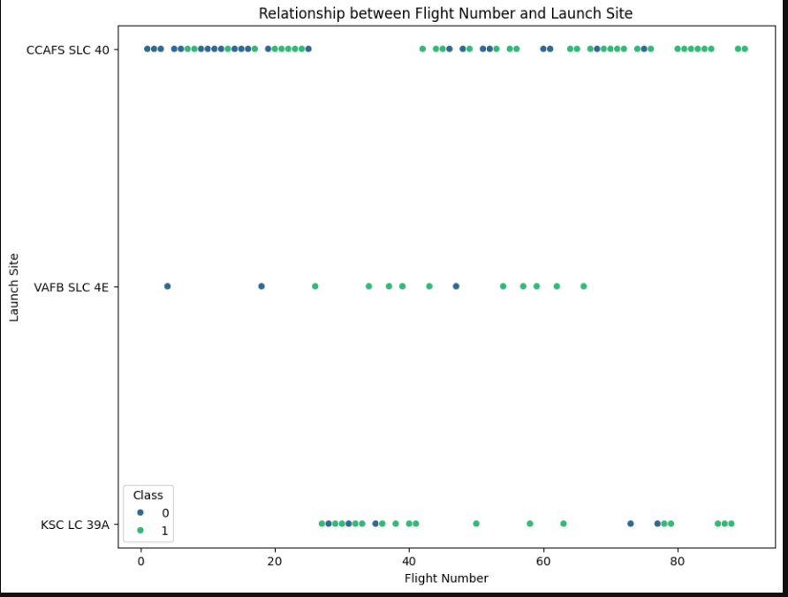
We see that different launch sites have different success rates. CCAFS LC-40, has a success rate of 60 %, while KSC LC-39A and VAFB SLC 4E has a success rate of 77%
Flight Number vs. Launch Site
We can observe a positive correlation between the number of launches and the success of the launches. We see that different launch sites have different success rates. CCAFS LC-40, has a success rate of 60 %, while KSC LC-39A and VAFB SLC 4E has a success rate of 77%

Slide 19
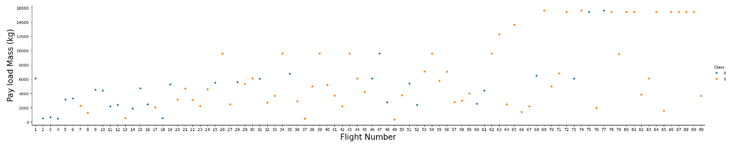
Payload vs. Launch Site
From the scatterplot, we can notice a positive correlation between Flight number and Payload Mass. As the flight number increases, the first stage is more likely to land successfully. The payload mass is also important; the more massive the payload, the less likely the first stage will return.

Slide 20
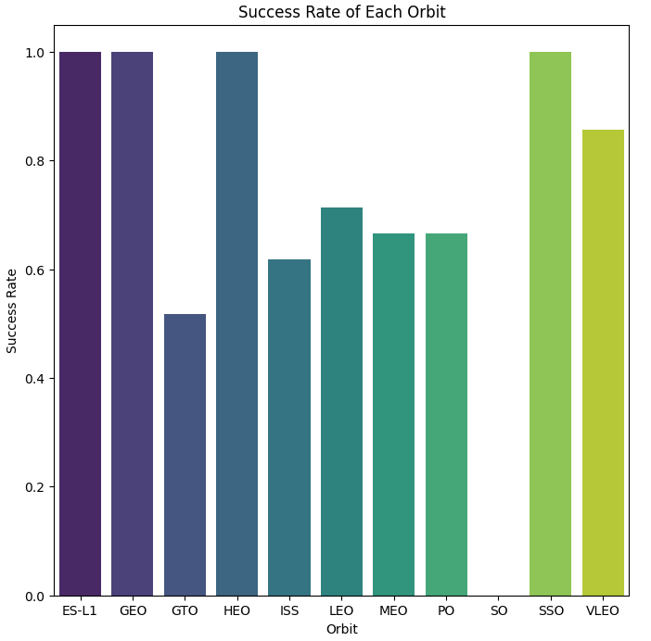
Success Rate vs. Orbit Type
This bar plot allows to visualise the success rate of each orbit, providing insight into which orbits have the highest and lowest success rates. It helps understand the performance of Falcon 9 launches in different orbital trajectories.
We can observe that Orbits ES-L1, GEO, HEO, and SSO have a higher success rate.

Slide 21
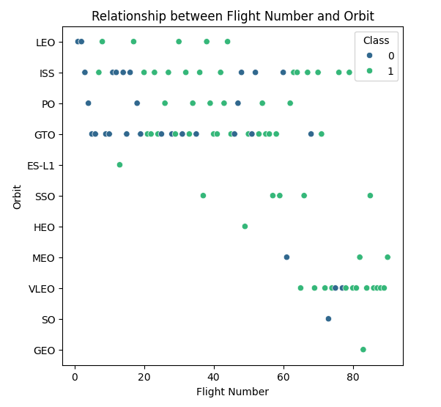
Flight Number vs. Orbit Type
The scatter plot allows to visualise the relationship between Flight Number and Orbit, with different classes distinguished by color. It helps understand how the Flight Number and Orbit variables relate to each other and how they might correlate with different classes.
For example, in LEO orbit, Success appears related to the number of flights; conversely, there seems to be no relationship between flight numbers when in GTO orbit.

Slide 22
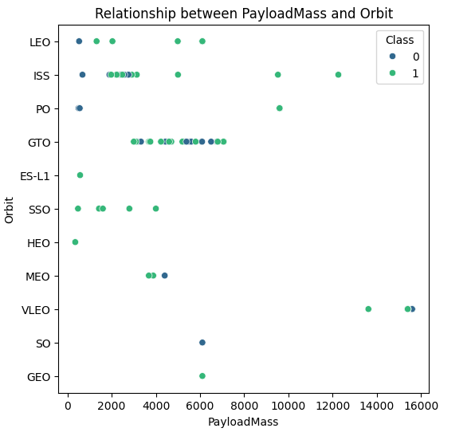
Payload vs. Orbit Type
With heavy payloads, the successful landing or positive landing rate is higher for Polar, LEO and ISS.
However, we cannot distinguish this well for GTO as both positive landing rate and negative landing(unsuccessful mission) are there here.

Slide 23
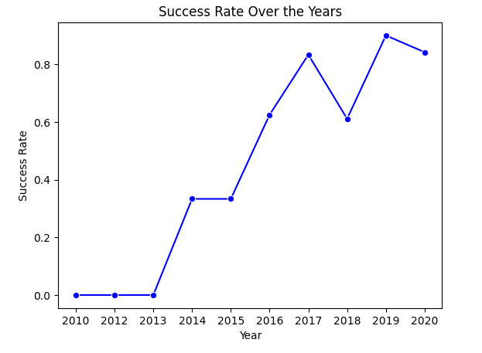
Launch Success Yearly Trend
We can observe that the success rate since 2013 kept increasing till 2020

Slide 24
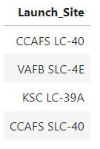
All Launch Site Names
The query result is the list of the names of the unique launch sites of distinct values from the Launch_Site column in the SPACEXTABLE table, ensuring that each launch site appears only once in the output.

Slide 25
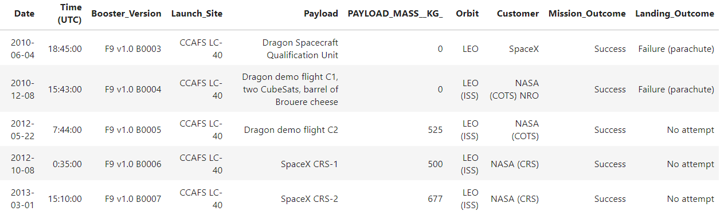
Launch Site Names Begin with 'CCA'
The query returns the first 5 rows from the SPACEXTABLE where the Launch_Site column starts with 'CCA'.

Slide 26
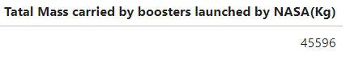
Total Payload Mass
The query will return the total payload mass carried by boosters launched by NASA (CRS) in kilograms.

Slide 27
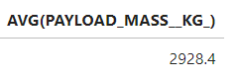
Average Payload Mass by F9 v1.1
The query returns the average payload mass carried by boosters with the version 'F9 v1.1'.

Slide 28
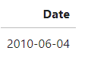
First Successful Ground Landing Date
The query returns the date of the earliest successful mission recorded in the SPACEXTABLE.

Slide 29
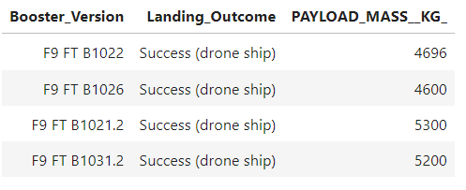
Successful Drone Ship Landing with Payload between 4000 and 6000
The query will return information about the booster version, landing outcome, and payload mass for successful landings on the drone ship with a payload mass between 4000 kg and 6000 kg

Slide 30
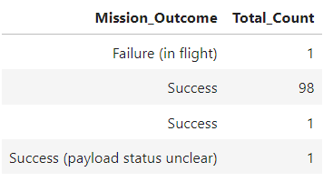
Total Number of Successful and Failure Mission Outcomes
The query will return the total number of successful and failed mission outcomes from the SPACEXTABLE table, grouped by the respective outcomes, for a total of 99 successful missions.

Slide 31
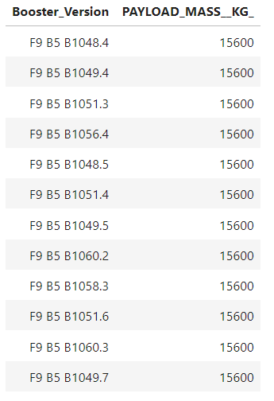
Boosters Carried Maximum Payload
The query will return the names of the booster_versions that have carried the maximum payload mass recorded in the SPACEXTABLE table.

Slide 32
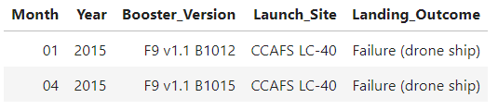
2015 Launch Records
The query will return the month, year, booster version, launch site, and landing outcome for missions in 2015 with a landing outcome of 'Failure (drone ship)'.

Slide 33
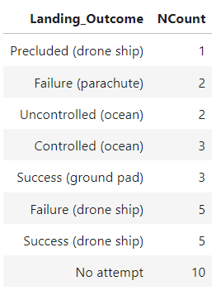
Rank Landing Outcomes Between 2010-06-04 and 2017-03-20
The query returns the count of each landing outcome for missions that occurred between June 4, 2010, and March 20, 2017, sorted in ascending order of counts.

Slide 34

Section 3

Slide 35
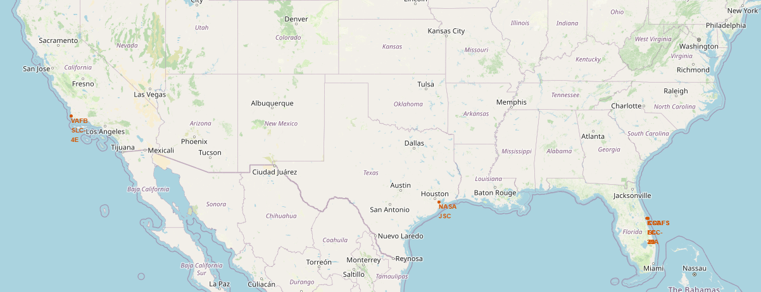
Launch sites on a map
As we can notice, all launch sites are near the Equator line and very close to the coast. If a spacecraft is launched from a site near Earth’s equator, it can take optimum advantage of the Earth’s rotational speed.
If and when a rocket fails, it has the potential to drop tons, of debris and unused propellant onto a potentially populated area; therefore, it makes sense that a rocket should be launched over an area with as little chance of collateral damage.

Slide 36
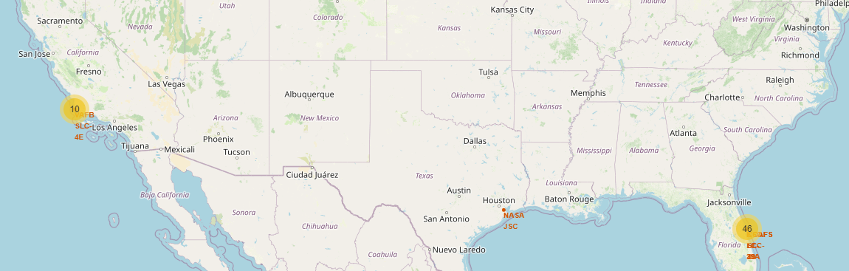
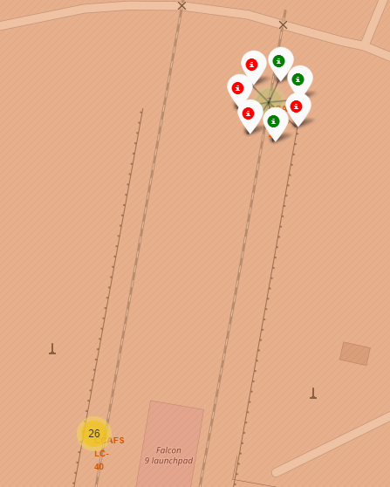
Success/failed launches for each site on the map
We provide an interactive map visualization of SpaceX launch sites, clustering them for better visualization and indicating the success or failure of each launch through marker colors.

Slide 37
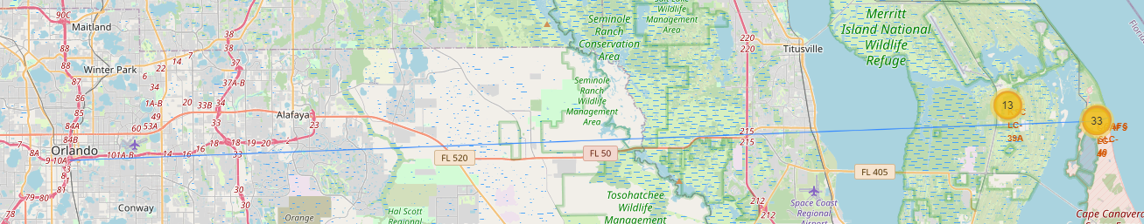
Distances between a launch site to its proximities 3
We can notice that launch sites are not near railways, highways or cities. Instead, they are in close proximity to the coastline.
If and when a rocket fails, it has the potential to drop tons, of debris and unused propellant onto a potentially populated area; therefore, it makes sense that a rocket should be launched over an area with as little chance of collateral damage.

Slide 38

Section 4

Slide 39
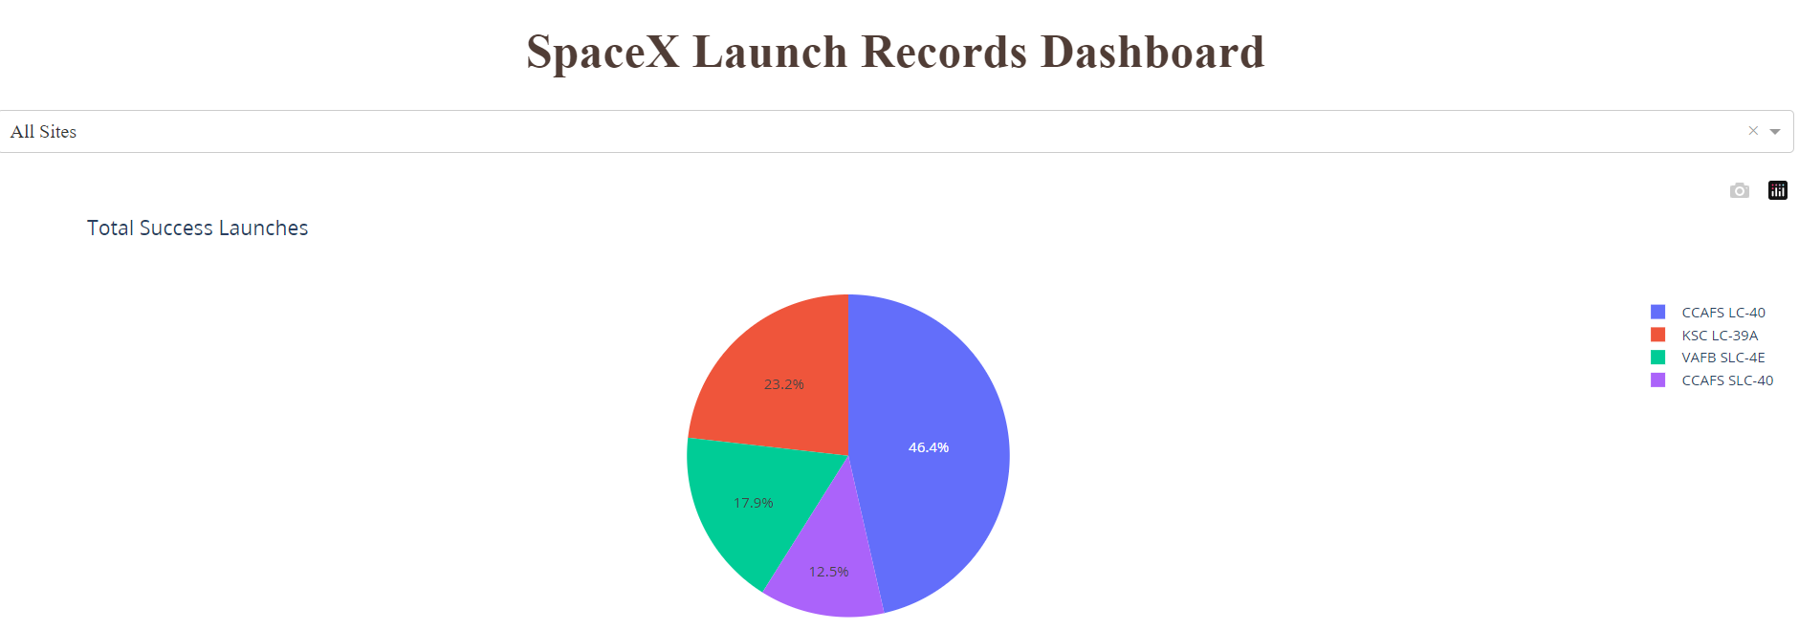
Total Launches by launch site
From the Dashboard, we can observe the total distribution of launches by launch site. We can notice that CCAPS LC-40 report the highest percentage of launches.

Slide 40
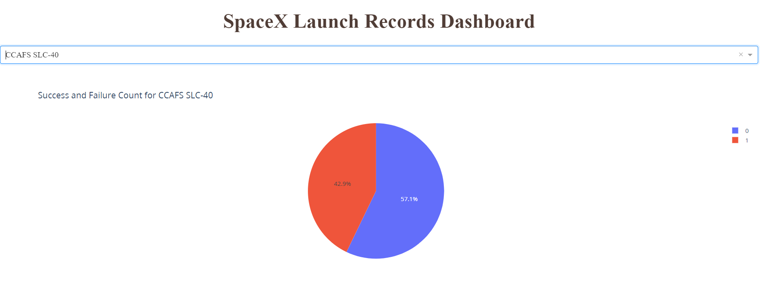
Launch site with highest launch success ratio
Below is the screenshot of the pie chart for the launch site with the highest launch success ratio. We can notice that the CCAFS SLC-40 launch site has the highest percentage of successful launches, 42,9%.

Slide 41
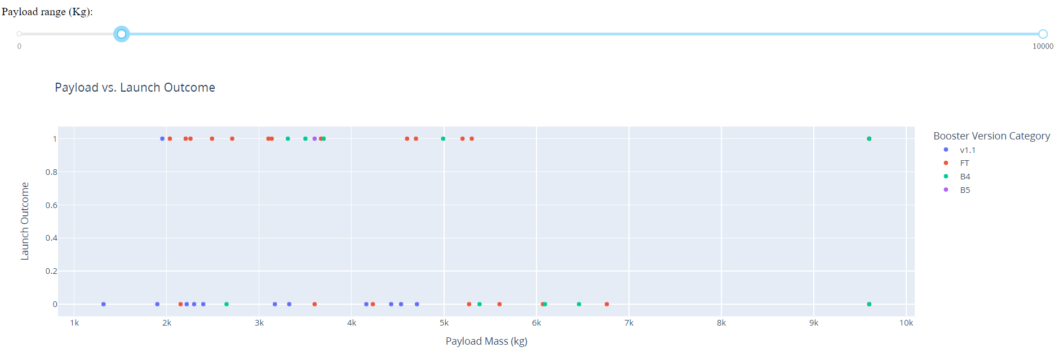
Payload vs. Launch Outcome
From the scatterplot for all sites, with different payloads selected and booster version, we can notice that we have the largest success rate with a payload between 2k and max 6k and boost version FT.

Slide 42

Section 5

Slide 43
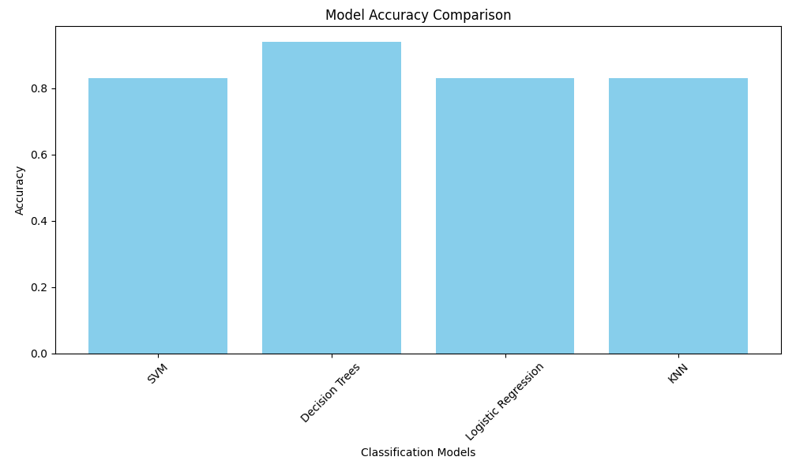
Classification Accuracy
The below bar chart visualizes the built model accuracy for all built classification models implemented. Decision Tree is the model that has the highest classification accuracy of 0.94

Slide 44
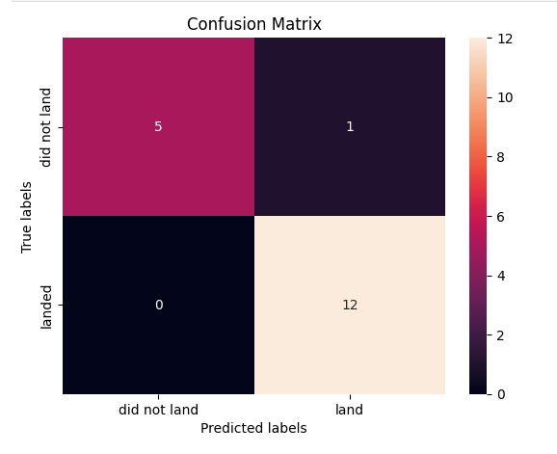
Confusion Matrix
The decision tree model is able to predict correctly a launch site’s success and failure with a 94% accuracy. From the confusion matrix, we can notice that applied on the test data was able to correctly predict 17 cases with only one false positive.

Slide 45
Conclusions
The dataset chosen offers very good results from applying exploratory data analyses and data visualization, such as the relationship between features like payload mass and launch outcome, the best location to conduct the launches and the best boost version. Thanks to the dashboard, it is easy to notice that the CCAFS SLC-40 launch site has the highest percentage of successful launches, 42,9%. And payload between 2k and max 6k and boost version FT.
We can conclude that the Decision tree is the best model to adopt to predict launch outcomes with an accuracy of 0.94. This means that the model can predict on the test set with an accuracy of 94%.
Because of the limited number of test sets, only 18 samples would be useful to gather more recent data to conduct tests further and compare the models again.

Slide 46
Appendix
GitHub link to complete project https://github.com/clorofilla/SpaceX-Project.git

Slide 47


